Slide 1
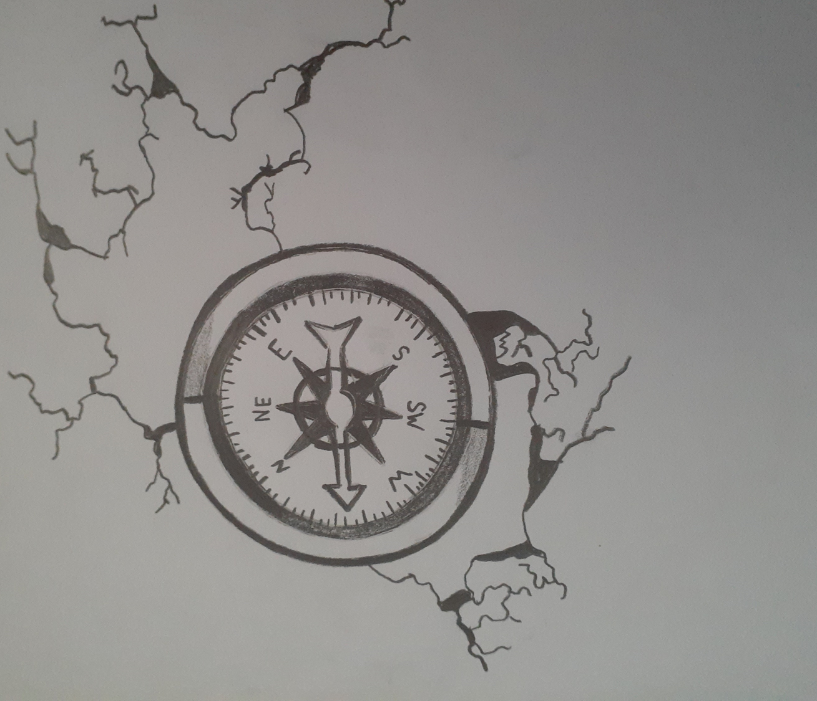
“The drawing signifies me not knowing where I was going, what I was doing, or how I was feeling. The cracks signify brokenness physically and emotionally that I experienced. I was finally able to find my direction when I was placed somewhere to learn new coping skills, and how to express my feelings. I learned that drawing could help me work through what I am feeling and how to express what I am going through.” - LGW

Slide 2
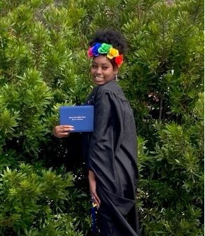
Ever since I was a little girl, I had big dreams, but I never had big support to help me out with my plans for my big dreams.
My life wasn’t always the best but when I came into San Luis Obispo county, the social workers helped me progress in so many ways.
They try and never stop trying until their job is done. Even if I wanted to give up as a person on working on myself, they would not stop trying or helping me ~TJ

Slide 4
‘’I was able to grow in my experience. Through the support of my mother, I was able to heal, feel love and love myself. ‘’

Slide 5
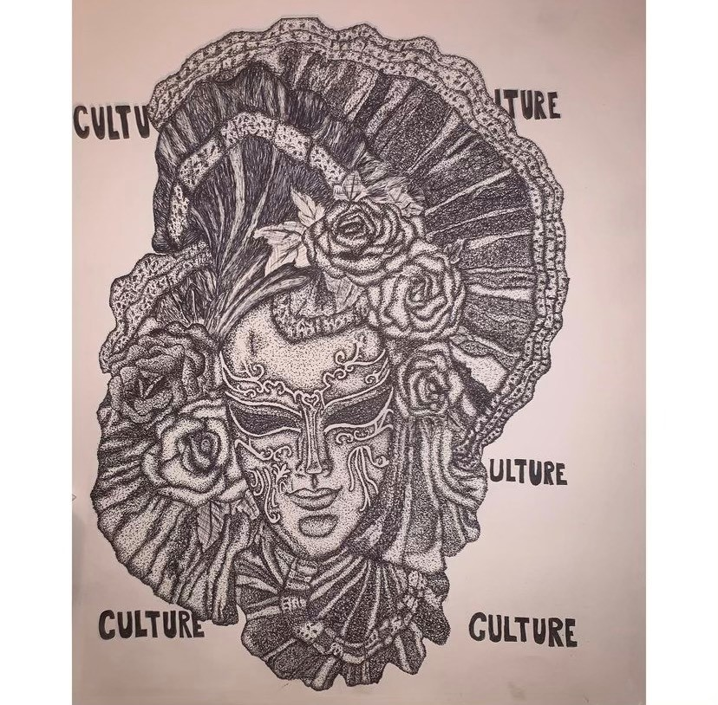
"Art has not only been a way for me to express myself, art also has been a way for me to cope with any realities I face that may be challenging."
- AL

Slide 6
"Art has not only been a way for me to express myself, art also has been a way for me to cope with any realities I face that may be challenging."
- AL

Slide 7
My experience in care was unfathomable. The Resource Family I lived with for 9 years was just as traumatizing to me as the one I left, if not more so. I didn’t have a voice. The placement was approved and monitored by social workers. I felt that given that the adults in charge of making sure I was in a good home didn’t remove me – my experience was normal. It in fact wasn’t normal, and I was just one of the youth that “fell through the cracks.” I was removed from that home less than a month after my 17th birthday, not because the social workers finally paid attention to the black ink printed in their reports – but because I called them to let them know that I left and refused to return. You can only gamble your life so many times before your luck runs out. 6 months later I suffered from a mental breakdown due to my experiences in my short life. The road to recovery has been difficult. I was 20 years old when I finally felt genuine happiness. I didn’t even know what it was. At 22 years old I began to comprehend the chance of a future. Now at 23, I am becoming a person. I am developing a personality, and a purpose in life. It’s nice. ~

Slide 8
What is the Youth Engagement Project (YEP)?
The Youth Engagement Project is collaboration between SLO County DSS and current and former foster youth to incorporate youth voice in program and policy development in our community and at the state level.
Opportunities:
Help make positive changes for children in families in our community by sharing your voice and get paid, connected to additional professional opportunities and have fun with our SLO YEP team!
Stipend:
Youth Ambassadors receive professional compensation including a minimum $200 monthly stipend.
Why join?
Meet New People ! Make a difference In your community! Get Paid!
We NEED Your VOICE!
To find out more on how you can become a YEP Ambassador contact:
Leann Ross lross@co.slo.ca.us (805)781-1871

Slide 9
At any given time, there are over 350 children, youth, and teens in foster care in San Luis Obispo County. These youth are in care through no fault of their own and are the victims of abuse, neglect, or abandonment. There are many ways you can help and together with the caring individuals and families in our community, we know we can find safe, loving homes for every child in care. If you or someone you know has space in your heart and home, and are interested in supporting our youth in care, please visit our website at www.slofostercare.com or call 805-781-1705.

